Slide 1
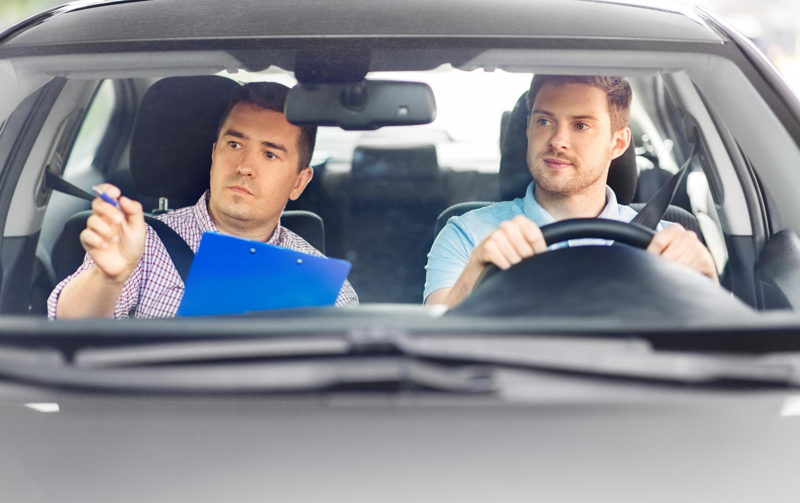

POWERED BY
LOCAL SEO
FROM BASICS
TO MASTER CLASS
+ AI STUFF

Slide 2

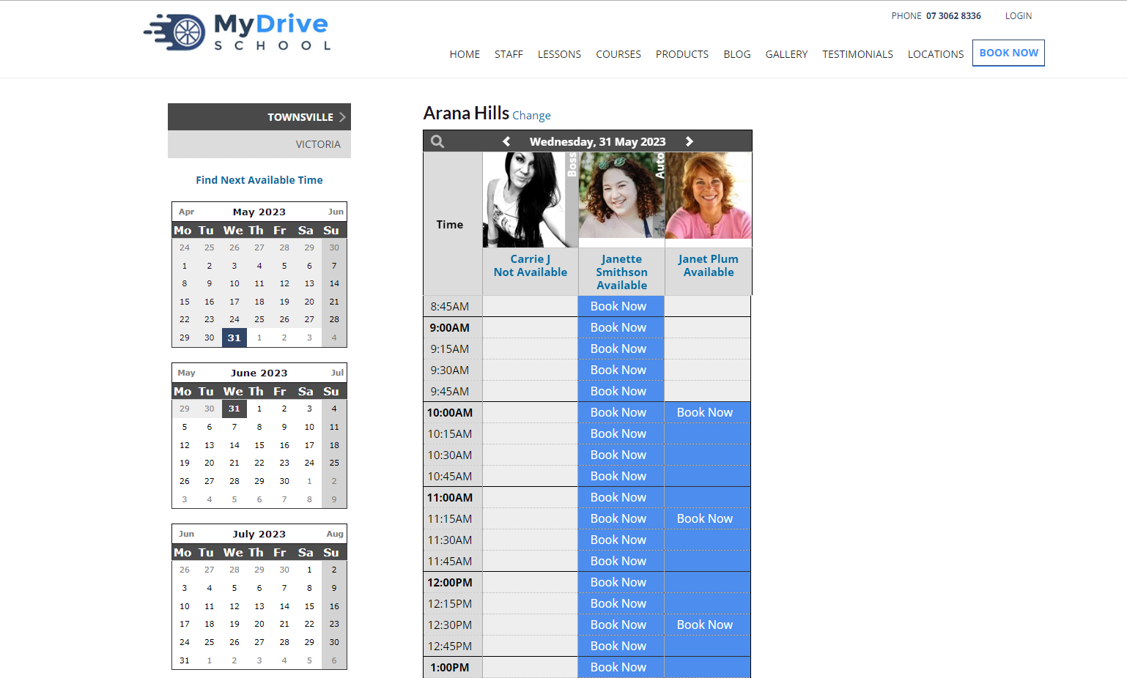


Hi, I'm Carrie Mae
Why do you care?
A Global Strategist for BookingTimes
Work with 1,000s of Driving Schools
Have insider information (AKA real data)
SEO Expert
Understands pain points of Driving School World

Slide 3

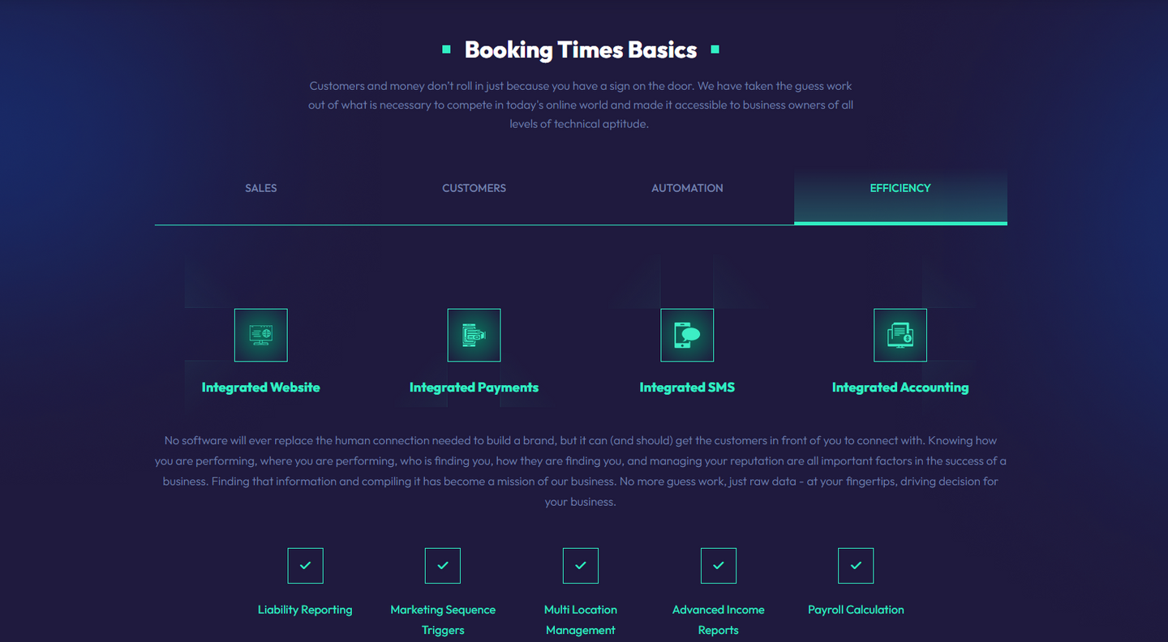
What is BookingTimes?
I designed this
Australian Based Business Platform
90% of clients are Driving Schools
In Business over 16 years
Client driven upgrades
Growing quickly and dominate the first page - Google “Driving School Brisbane”
Eat, sleep, breathe driving school data
Most Loved for: online scheduling, online LMS, integrated website, built in SEO.
And me.

Slide 4

01
Core Values
01
03
Why are you doing this?
How do you define success?
02
04
Who are you doing this for?
What is your business culture?

Slide 5


Core Value Examples:
Work with people we value, and who value our work.
Value our team first, for the benefit of our clients always.
We learn from our mistakes, we don't drown in them.
Come to the table with solutions.
Create sustainable drive.
Build our business on reputation, not pontification.
except me. I toot that horn.

Slide 6

02
On a mission.
A Mission Statement is: a formal summary of the aims and values of a company, organization or individual.
What is not a mission statement?
30 page thesis
A manifesto

Slide 7
Mission Statement Example:
Our mission is to give our clients a foundation in which their potential for growth is limited only by their drive, not their technical capabilities.
I get to work here!!!!

Slide 8





Values Make Decisions
Strategy
Message
Goals
Culture
Without a plan, even the most brilliant business can get lost.
- Yogi Berra
Culture is what motivates and retains talented employees.
-Betty Thompson
Policies
Procedures

Slide 9





03
Define Your Perfect Customer
The Profile
Language
Be specific.
Millenials vs Gen X vs Gen Z.
Affluence
Service Area
Remember...you run a business.
Travel time is a killer.

Slide 10
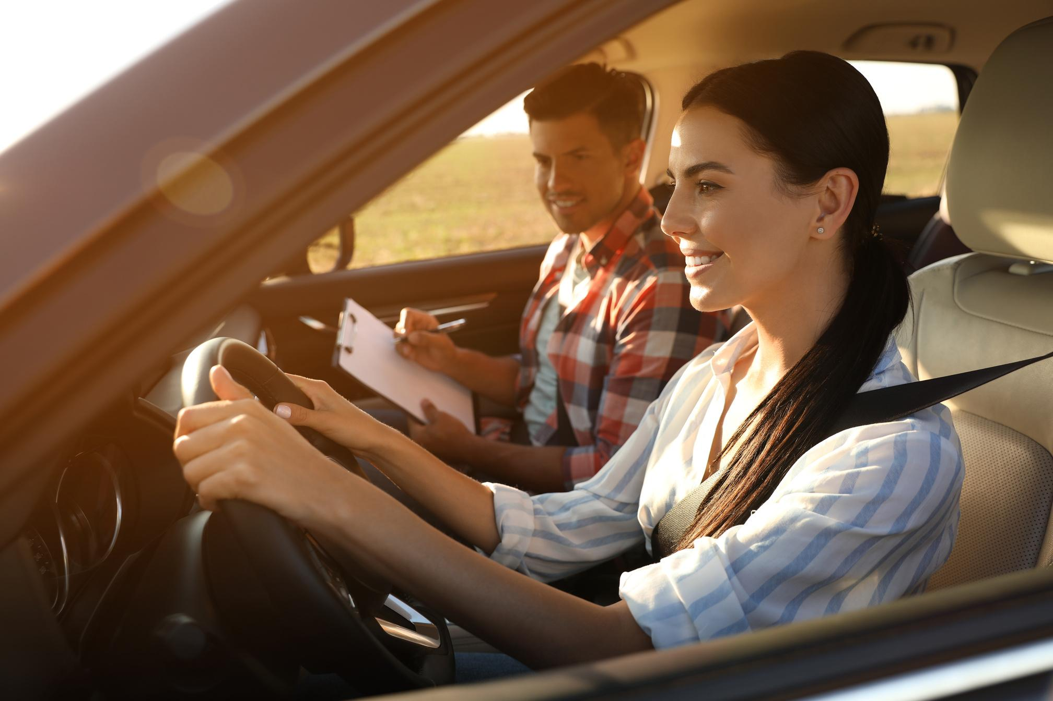
Hiring Strategy
Largest struggle for growing schools.
A.B.H
Bottle Neck
Loyalty through buy-in
Leadership
Retention
Develop your employees, and you'll develop your company.

Slide 11
Customer Support
01
03
Can NOT be replaced
Must align with values
BT is miraculous.....but it's not a human.
See slide 4.
02
04
Must be personal
Must be sustainable
Everyone is fighting a war.
People are crazy.

Slide 12
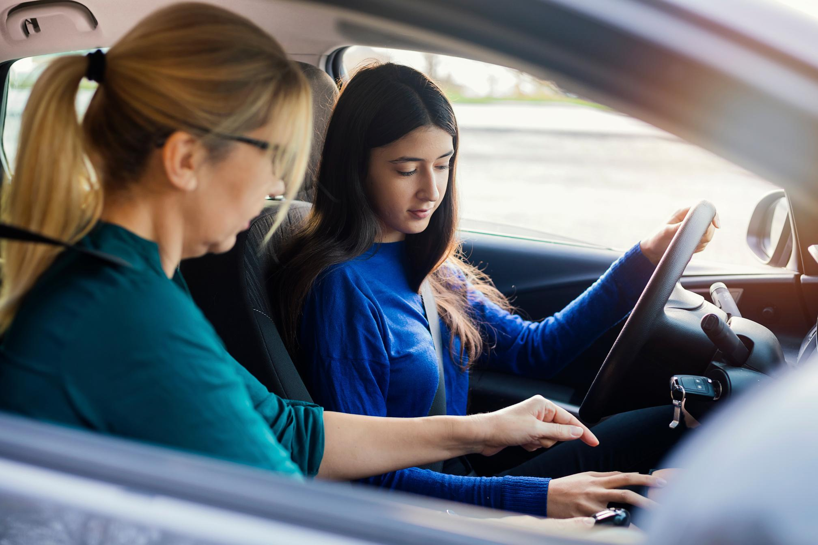
Customer Trends & Goals
Churn Rate
Consider:
Demographic
Follow Up
Number of Bookings
Consider:
Cost to acquire
Retention methods
Customer feedback

Slide 13
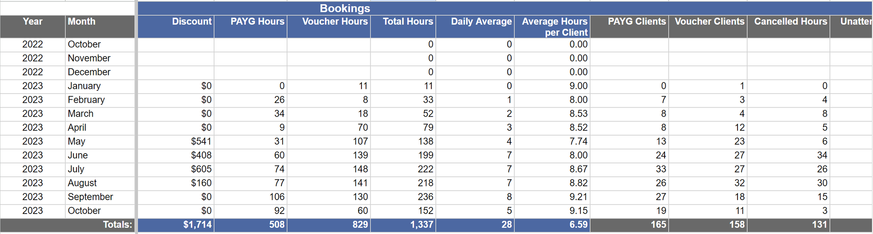

Slide 14

SEO TRUTH BOMB

Slide 15

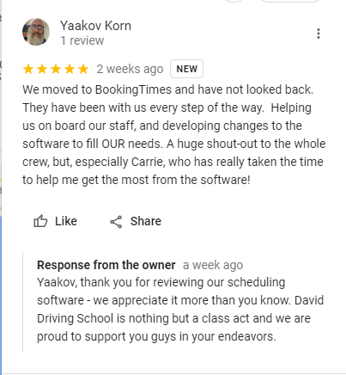


The Google Game
......local edition
Google Business Profile
The NAP Profile
The Website
The Bookings Link
The Services
The Products
The Offers
THE REVIEWS
.....10 million dollar advice

Slide 16
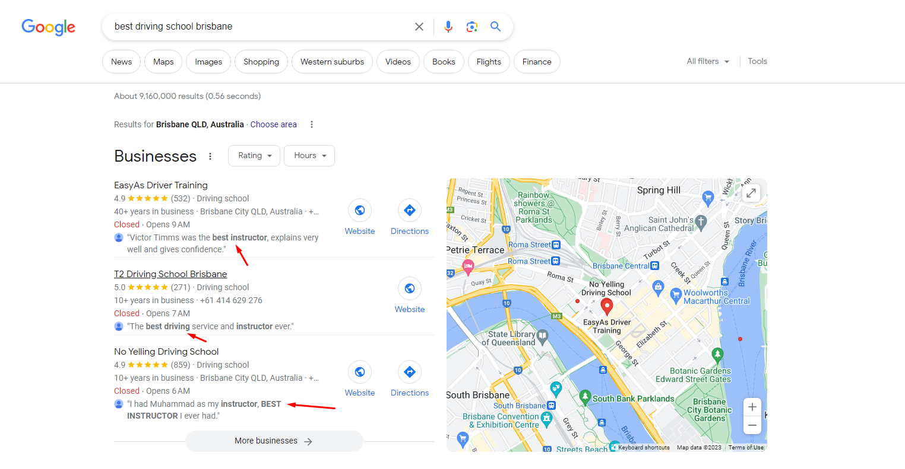

Slide 17


Technical Requirements
Don't Block Us
The Page(s) Work(s)
The page(s) has(have) content

Slide 18
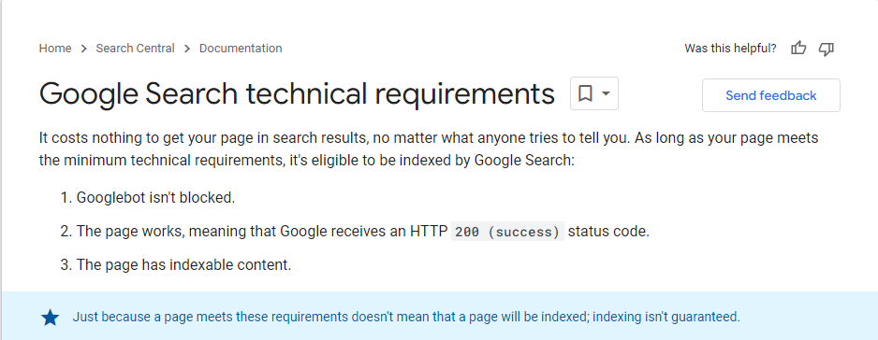


Slide 19







Artificial Intelligence (AI)
Scheduling
Sales
Reminders
Cancellations
Terms
Payroll
Procedures
Reporting

Slide 20


What About AI SEO
How SEO Crawlers Work vs. How LLMs Learn and Retrieve Info
SEO Crawler
LLM “Seeker”
“Scan” code
Follow links
Index Keywords & Meta
“Look For” Technical Signals
Frequently Recrawl to Update
“Digest” Snapshots of info
Use Probability to associate
Find Relationships
“Look For” Context & Clarity
Occasionally Check in to Update
RANK
RECOMMEND

Slide 21

AI as the new Fuel in Your Business -
Basic Marketing/Sales
Smarter Ads
Instant Response
Consistent Brand
AI analyzes what ads convert by time, suburb, and keyword
Automatically shifts spend to what’s working — no guessing
Tracks ROI from every click to every completed test
Chatbots and SMS responders handle leads within seconds
Personalized replies feel human — but they never sleep
Converts night-time inquiries into morning bookings
Auto-generates blog posts, social media posts, and email content
Keeps your tone and brand voice consistent across channels
Learns from engagement — improves every week

Slide 22
Where AI and SEO Meet
A Beginner
you’re guessing.
you post random content.
you hope google likes you.
you rely on “word of mouth.”
.....10 million dollar advice

Slide 23
Where AI and SEO Meet
An Intermediate
you pick a perfect customer.
you track your bookings.
you know your COA (cost of acquisition).
you use local SEO intentionally.

Slide 24
Where AI and SEO Meet
Master Class
you use the data to decide the next move.
AI becomes the force-multiplier.
you feed it your language, your customers, your patterns.
and it improves your odds every cycle.

Slide 25
How to Optimize.
1 Service - 1 Page
Content for a 5th Grader
Localize heavily — city + suburb + neighborhood references
Get reviews that mention LOCATION + SERVICE (“manual in Southport”)
Focus on page signal > volume
Make it stupidly:
WHO you are
WHAT you do
WHERE you do it

Slide 26
Questions For your SEO Team
What is my URL/Keyword Alignment strategy?
Is there one H1 per page?
Have you added all alt attribute?
Are we writing content for LLM’s?
Do we have an LLMS.txt?
Do we have FAQ’s that are page specific?
If I’m ranking........where are you measuring it from?
When are you measuring my rankings?
Are you scanning for orphaned pages?
Or send me their report.

Slide 27

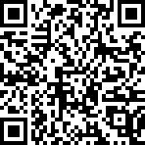
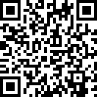
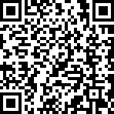
Questions or Comments?
More About BT
Contact Carrie
Download Presentation

