Slide 1



AI in The Drivers Seat
Smarter Training for a New Generation
Presented by: Carrie Mae Nelson & Maverick
Powered by:

Slide 2


POP QUIZ
What is AI?
AI:

Slide 3
Rule-based: Follows orders.
Machine learning: Learns from data.
Deep learning: Learns really well from tons of data.
Generative AI / LLMs: Writes, talks, creates.
Predictive AI: Forecasts what’s next.
Robotics / Vision: Sees and acts.
What’s the Difference?
Notes:
1️⃣ Rule-Based AI — “If this, then that.”
🧩 What it is: Old-school logic. Follows fixed rules made by humans.
🚦 Example: “If student is under 18 → show parent consent form.”
💡 How to explain it: Smart, but only inside the lines you draw.
2️⃣ Machine Learning — “It learns from data.”
📊 What it is: Finds patterns and improves with experience.
🧠 Example: Learns which students usually cancel or no-show.
💡 How to explain it: Like an instructor who gets sharper after 1,000 lessons.
3️⃣ Deep Learning — “It learns from huge data.”
🌐 What it is: Advanced version of ML that mimics the brain’s layers.
👁️ Example: Detects stop signs or traffic lights in self-driving cars.
💡 How to explain it: Fast learner—but doesn’t really understand why.
4️⃣ Generative AI (LLMs) — “It creates stuff.”
✍️ What it is: Large Language Models (like ChatGPT) that write, plan, and explain.
📧 Example: Writes your marketing posts or student reminder emails.
💡 How to explain it: Like an assistant that never sleeps—but needs clear directions.
5️⃣ Predictive AI — “It guesses what’s next.”
🔮 What it is: Uses past data to make smart predictions.
📅 Example: Spots which students might cancel or fail their test.
💡 How to explain it: Not magic, just math on overdrive.
6️⃣ Robotics & Vision — “It sees or moves.”
🚗 What it is: AI that controls motion or recognizes visuals.
🎮 Example: Simulators or automated driving systems.
💡 How to explain it: The part that watches and reacts in real time.
🏁 Wrap-Up Slide: So What’s Relevant for You?
For driving instructors, focus on:
✅ Generative AI — to write, plan, and communicate faster.
✅ Predictive AI — to improve scheduling, marketing, and retention.
✅ Rule-Based AI — already inside your booking and compliance tools.

Slide 4

What’s the key Difference?
Errors
Notes:
“AI gives you more data. It’s your humanity that makes it meaningful.”

Slide 5
How Humans Learn
How AI Learns
Learns by experience
emotion and repetition shape instinct.
Driven by emotion
pride, fear, empathy, reward.
Adapts to people and context.
Makes intuitive calls on tone and pacing.
Exercises moral reasoning and judgment.
Retains meaningful memories.
Learns by data exposure
repetition and error reduction.
Driven by optimization
numbers, loss functions, weights.
Applies generalized models.
Makes probabilistic calls on data trends.
Executes programmed ethics and policies.
Retains statistical weights.
Notes:
“AI gives you more data. It’s your humanity that makes it meaningful.”
Humans learn (brain cells form and strengthen connections) through sensory experience, abstraction, and social interaction. We generalize from small data.
AI learns from massive datasets and patterns—it’s brute-force pattern recognition, not lived understanding.
In short: humans learn through stories and stakes; AI learns through statistics and structure. One grows from life; the other from loops.

Slide 6
Smarter Learning, Not Lazier
Is AI Dangerous?
“ChatGPT May Be Eroding Critical Thinking Skills, According to a New MIT Study” - Dr Nataliya Kosmyna MIT
ChatGPT users “consistently underperformed at neural, linguistic, and behavioral levels.”
55% lower cognitive engagement for GPT Users (48% for Google)
“The State of AI in Early 2024: Gen AI adoption spikes and starts to generate value.” McKinsey Global Survey, May 2024.
Notes:
The study divided 54 subjects—18 to 39 year-olds from the Boston area—into three groups, and asked them to write several SAT essays using OpenAI’s ChatGPT, Google’s search engine, and nothing at all, respectively.

Slide 7
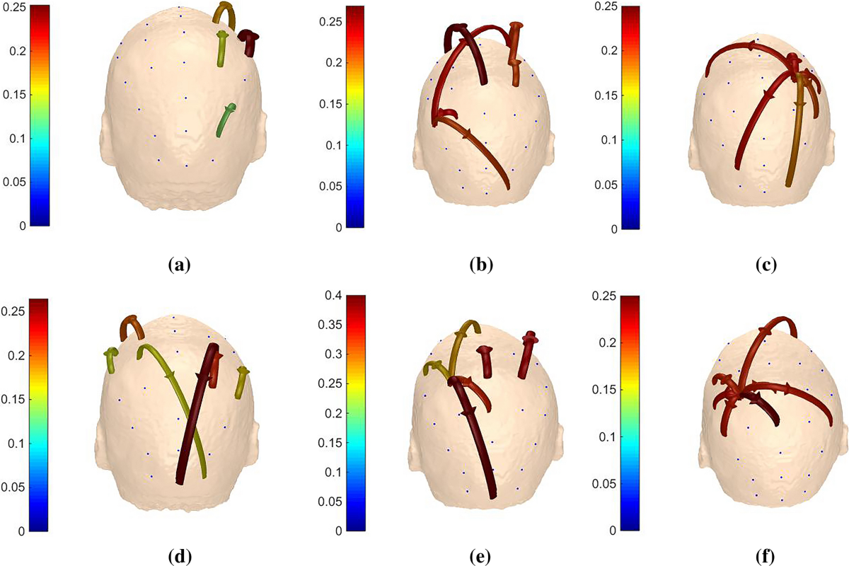
Dynamic Directed Transfer Function
Is AI Dangerous?
Notes:
This study used Dynamic Directed Transfer Function of dDTF

Slide 8
Driving and the Brain
Is it growing?
“Navigation-related structural change in the hippocampi of taxi drivers”
The posterior hippocampi of taxi drivers were significantly larger relative to those of control subjects.
It seems that there is a capacity for local plastic change in the structure of the healthy adult human brain in response to environmental demands.
Maguire et al., Proceedings of the National Academy of Sciences, 2000; follow-up work confirms hippocampus growth with navigation expertise.
Notes:
The study divided 54 subjects—18 to 39 year-olds from the Boston area—into three groups, and asked them to write several SAT essays using OpenAI’s ChatGPT, Google’s search engine, and nothing at all, respectively.

Slide 9
The Role of Instructors
Old model: instructor as information gatekeeper
New model: instructor as interpreter, coach, and emotional compass
“The State of AI in Early 2024: Gen AI adoption spikes and starts to generate value.” McKinsey Global Survey, May 2024.
Notes:
“AI gives you more data. It’s your humanity that makes it meaningful.”

Slide 10



AI Operations: How it Applies
I Teach, It Learns
You provide data
Smarter, Not Harder
You Provide Input
Your Insights + AI’s Data
It poops out the plan
Record student behavior and progress.
The system adapts future lessons automatically.
AI builds lesson plans from your notes.
Keeps structure consistent and personalized.
Predicts struggles early.
Helps you focus on the human, not the paperwork.
Notes:
AI doesn’t replace your team. It replaces your chaos.

Slide 11
AI + Instructor
The Perfect Team
Let’s Build a Lesson Plan

Slide 12
AI Lesson Builder:
Prompt Data
1
2
3
Static Information
Skill Assessment
Learning Environment
Name
Age
Location
Experience
Procedural/Skill Assessment
Emotional State
Comfort
Pacing Requirements
Motivations
Anxiety Rating
Notes:
From first click to final test, AI keeps your business in gear.

Slide 13
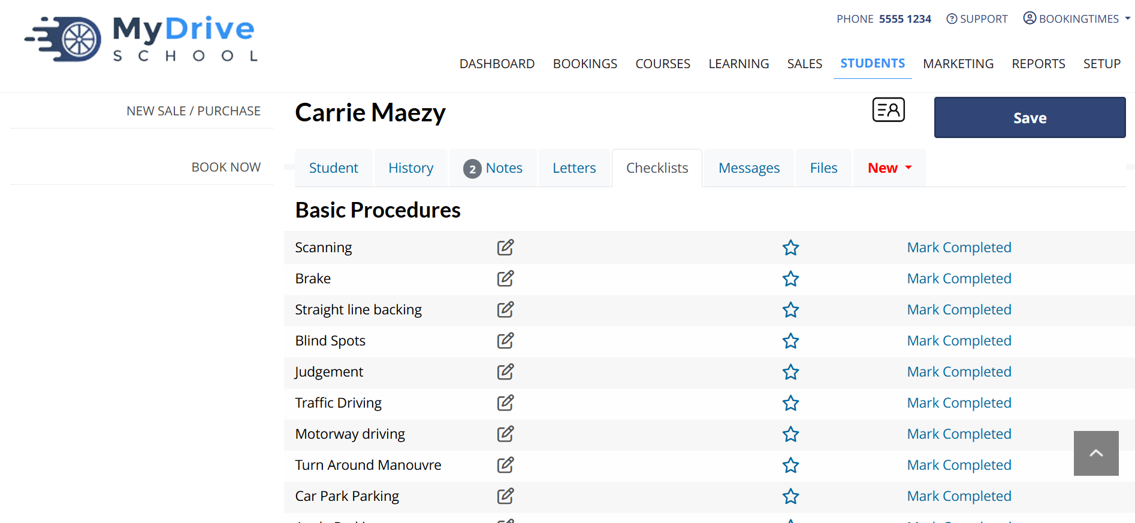

Slide 14
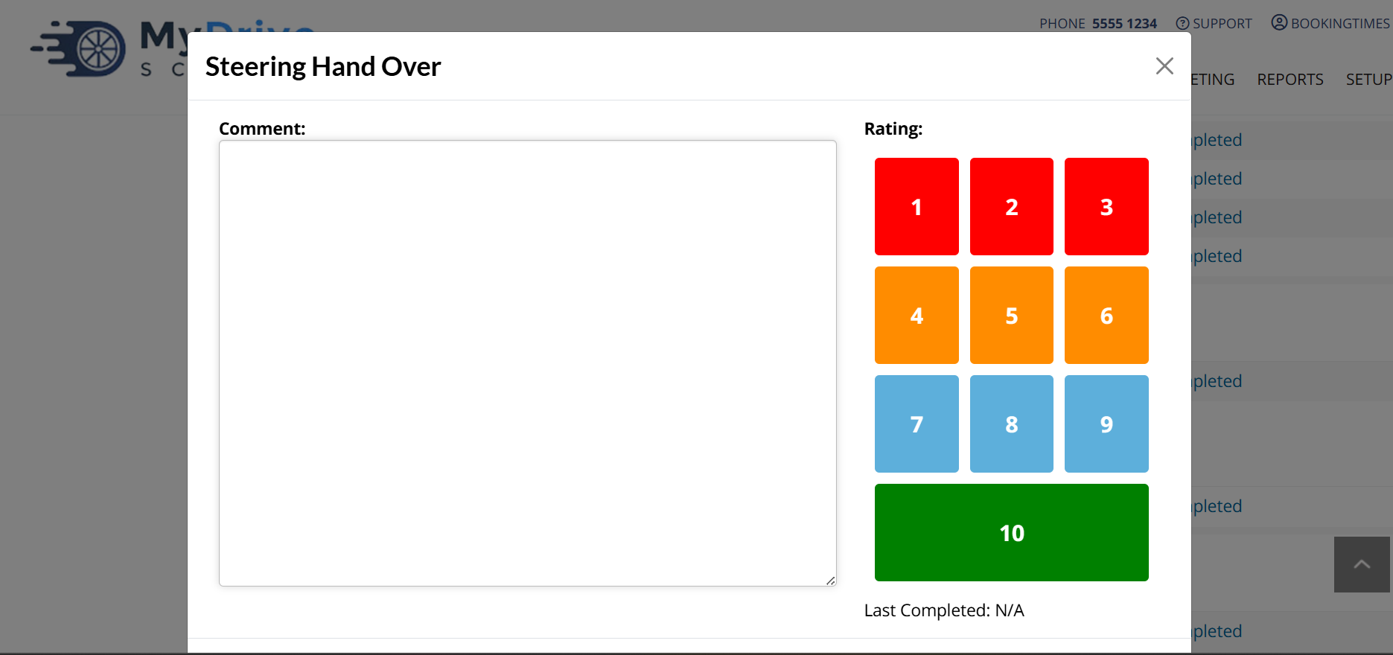

Slide 15
Our Prompt
"Analyze the driving school’s custom student progress checklist. The checklist uses varied grading criteria (e.g., pass/fail, yes/no, needs assistance) rather than a single numeric score. Identify the key performance categories and determine a logical lesson plan recommendation based on the results, taking into account the student’s age and the location of the school. Also, consider the lesson durations offered by the school (e.g., 1-hour, 90-minute sessions) and tailor the lesson recommendations accordingly. For example, if a student fails a critical safety item (like seatbelt use), add additional safety-focused lessons. Conclude with a recommended number of lessons tailored to the checklist results, the school’s criteria, and the available lesson lengths."

Slide 16
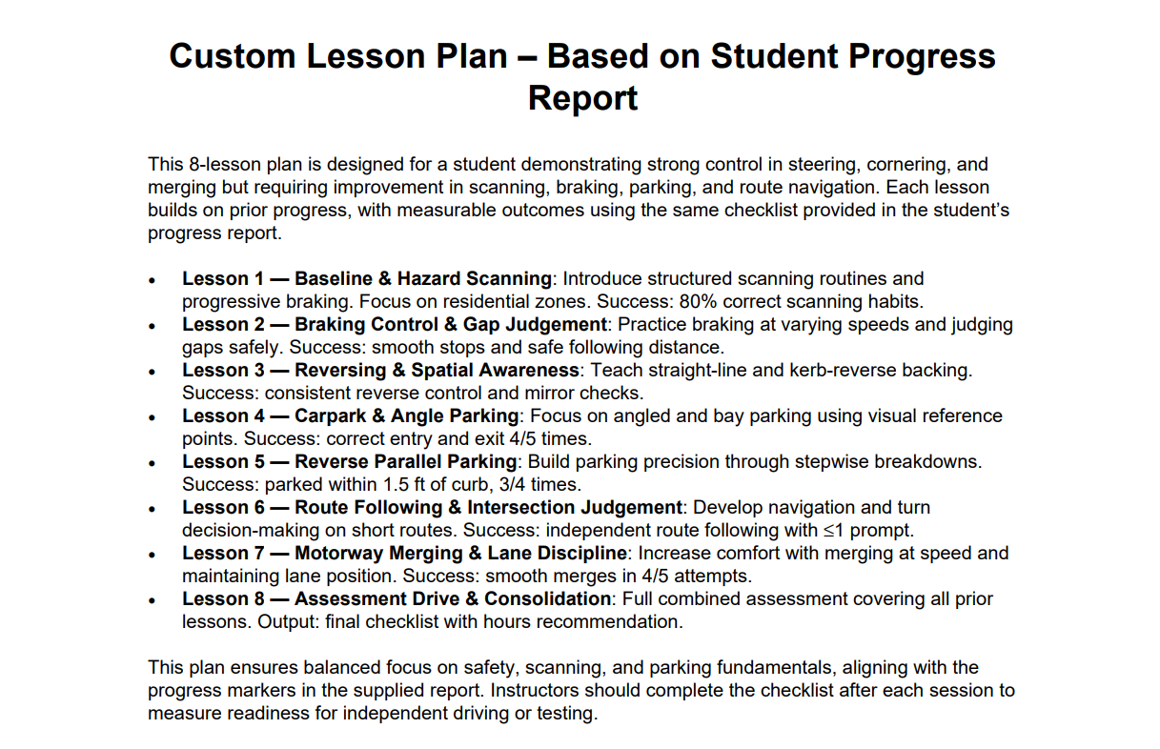

Slide 17
So What Now?
1
2
3
Gather Your Data
Centralize It
Automate With Purpose
(Seriously, all of it)
(This is where magic starts)
(Start with what hurts)
AI can’t optimize chaos. You need clean, consistent data — who’s teaching, who’s booking, who’s canceling, and when. If it lives in sticky notes and text messages or is stuck in software..... AI can’t find it - you can’t use it.
Put everything in one place — your lessons, students, payments, feedback and start building your prompts. Systems like BookingTimes already do that heavy lifting. The more connected your info, the smarter your AI can get.
Ensure that you’ve specified the outcome of the prompt and align it with the goals of the student for the most accurate output. AI is only as good as the prompt.

Slide 18
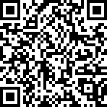
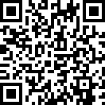
Questions or Comments?
More About BT
Contact Carrie

Slide 19
